Slide 1

2022
Internet Recharter Guide and Timeline
Notes:
The Internet Recharter Guide and Timeline was created to assist units and commissioners with managing their recharter on a timeline to allow them enough time to submit for proper review prior to their charter due date.

Slide 2
2022 Internet Recharter Guide and Timeline
What is a Charter & Who is Involved
Recharter Timeline
Keys to a Successful Recharter
  Membership Inventory
  Youth Protection Training (YPT)
  AB506
Internet Advancement & Common Pitfalls
Completing the Charter Process
Recharter Resources
Notes:
Tonight’s topics include:
We will not discuss each slide in great detail, but I highly suggest you take the time to read through each slide to understand the content.
There are two important notes I believe we can use have a dramatic impact and drastically improve recharter results for this year. So the information we are covering tonight will be focused on the process and required materials for recharter.
Helping your unit get started early on gathering data by following a timeline
Assigning a recharter champion to be the main point of contact for organizing and processing the internet recharter
I personally would suggest committee chairs take this as an opportunity to assign a delegate in my.scouting from their unit committee to assist if not be the main point of contact for the internet recharter.
Also please note this document is primarily for units who are completing a normal traditional charter through their current chartered org. There will be many other scenarios when it comes to units who might be doing affiliation agreements and/or seeking new charter organizations. If you fall in one of the special categories, please speak with your District Commissioner or District Executive.

Slide 3
What is a Charter?
What is a charter?
In the BSA, a charter authorizes an organization to operate BSA Scouting units. It certifies the agreement between a chartered organization and the Boy Scouts of America.
Why is a charter renewed annually?
Charters are usually issued for a period of 1 year; hence, chartered organizations must submit an application to the council annually to renew its charter.
Fosters a formal, timely plan for regular dialogue between charter organizations and BSA
Assures registrations are current so Scouts can participate in Scouting activities and advance in rank
Enables collection of annual membership fees
Notes:
Annually the local council enters into an agreement with the chartered organization granting them a charter. This charter enables the organization or group to use the Scouting program under adult leadership they approve of in order to accomplish its objectives and to serve the organization’s youth and families.

Slide 4
Who is Involved?
Committee Chairs / Unit Registrar (Key 3 Delegate)
Chartering Organizations (COR & EO/IH)
Unit & District Commissioners
District Executives
Council Registrar
Office Staff
Notes:
Committee Chair
Recruits a unit registrar to assist in the recharter process or takes on the role themselves.
Signs the charter and other forms confirming they are accurate.
Unit Registrar
Completes the recharter process online.
Completes the recharter process on time by submitting online in IA and DocuSign.
Executive Officer / COR
Confirms interest in continuing their partnership with the BSA.
Signs the charter and other forms confirming they are accurate (Adobe Sign and DocuSign)
Unit Commissioner
Guides unit through the recharter process.
Ensures on time completion of charter and submittal before deadline.
District Commissioner
Coordinates District Recharter Day
Confirms Commissioners Challenge
Communicates with units reiterating deadlines
District Executive
Works with district commissioner to plan district charter renewal workshop
Ensures on time submission of packets.
Confirms accuracy of forms and fees upon submittal.
Aggressively follows-up on incorrect or defective charters.
Council Registrar
Processes completed charters and notifies of defective issues.

Slide 5
SVMBC Recharter Unit Timeline
Internet Recharter Opens
Finalize Membership Inventory from fall recruiting
Final review: submit recharter & DocuSign
Attend Recharter Training
Council reviews and processes recharters
Assign Recharter Champion
Review Recharter Resources
Begin Membership Inventory
First Recharter Email Sent to Unit Key 3
DocuSign Packet sent to Unit Key3
Update Internet Recharter Roster
Confirm Key 3 approval
Identify Expiring YPT/AB506
Council Charter Due Date 5pm
Units resolve defects
Verify new Roster
Sept 15
Sept 30
Sept 30
Oct RT
Oct 15
Oct 15
Oct 1
Oct 7
Oct 1 to Nov 22
Nov 25
Dec
1
Dec 2
Dec 2-31
Jan 15
Sept 30– Oct 21
Oct 1 – Dec 1
Dec 2– Jan 15
Stage 1
Recharter Prep Stage
Unit assign recharter champion (Key 3 Delegate)
Review recharter resources
Begin membership inventory
Identify YPT expiring before Mar 1, 2023
Identify missing AB-506
Stage 2
Internet Recharter Stage
Update/Add/Remove members from roster
Collect fees & submit roster
Member of key 3 approves
AdobeSign Packet approved
Charter Org Agreement Signed and Submitted in DocuSign
2023 Unit Info, JTE and Commissioner Challenge submitted online *NEW*
Stage 3
Council Process Stage
Council receives recharter
Council Registrar validates recharter
Unit resolve defects or missing paperwork
Unit verifies My.Scouting roster
Council drops all units not submitted by Dec 29, 2022.

Slide 6
Keys to a Successful Recharter
Units can have a successful recharter by doing the following:
Start early!
Identify a recharter champion
  Complete membership inventory
  Check youth protection aging report
  Create a plan to collect fees
Review online training materials - (see slide 14 for links)
  FAQs
  Recharter user guide
  Recharter video
Review the Recharter Email series
Review the recharter timeline (slide 5)
Notes:
These Keys to a Successful Recharter will enable units to be extremely successful with understanding the overall process. The online training materials are important to review as this will help answer many questions before you even get started.

Slide 7
Membership Inventory
The Committee Chair or recharter champion should log into their my.scouting.org account and download a copy of their unit’s roster. Comparing the local unit roster against the official membership file will reveal any adults and youth who are not officially registered in the BSA. An application should be collected from any member on the unit roster that is not on the official membership file.
A committee member should contact every family to:
Verify members re-registering with the unit, noting what unit is their primary registration if in multiple units
Verify Scout Life subscription
Communicate fees and unit payment due date
Once the membership inventory is completed, retain the roster - needed during the data input process
Membership Inventory Report
My.scouting.org account and click on “MENU” on the top left of the page
Scroll down then click on the unit and select “ROSTER”
Select “EXPORT ROSTER” then click on “EXPORT TO CSV” and click on “CONFIRM”
The exported roster file will show up in a pop up box click on it
Save as an Excel file
If you have pending applications online or are holding onto paper applications,
approve/submit them ASAP to make this process smoother!
Notes:
Membership inventory is the one main task units can begin before logging into Internet Advancement for recharter. Membership inventories can be conducted throughout the year to ensure the roster is accurate.

Slide 8
Youth Protection Training
All registered adults must take Youth Protection Training (YPT) at least every two years. If a volunteer’s YPT is not current at charter renewal the volunteer cannot be registered. Units should not wait until it is time to renew the unit’s charter to make sure all YPT is current. Unit Key 3s should regularly review their unit’s YPT status.
Youth Protection Training Aging Report
Log into your My.scouting.org account and click on “MENU” at the top of the page on the left
Scroll down then click on the unit and select “YPT Reports”
Select “EXPORT to PDF or CSV” then click on “CONFIRM”
The exported roster will show up as a link to download or will open in a new window
Save the file
Review for any adults with YPT expiring before March 1 and contact them to retake YPT before submitting your final recharter paperwork
All Rechartering Adults Must have a YPT Renewal Date LATER than 03/31/2023 to proceed
Notes:
Youth Protection Training should be kept current when going through the recharter process and working with your adult leaders to let them know if they expire during the process is vital to avoiding delays. After running the report, make sure the adults are notified and given a due date to renew their YPT training.
It’s important to note YPT expiring before March 1 should be retaken for a December renewal.

Slide 9

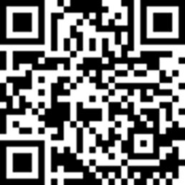
AB-506 and Charter Org Reps
A Charter Organization Representative would need to do fingerprinting and training for AB506 if :​
    They are a regular volunteer ​
    “Regular Volunteer” is any individual 18 years of age or older who volunteers his or her time and has direct contact with, or supervision of, minors for more than 16 hours per month or 32 hours per year.​
    They are a registered adult volunteer in another capacity, including volunteers for Cub Scouts, Scouts BSA, Sea Scouts, Venturing, Exploring, Order of the Arrow, Merit Badge Counselors, Council Board Members, and District Members.​
    A Charter Organization Representative would not need to do fingerprinting and training for AB506 if :
                They are a volunteer providing administrative support and if he or she does not have direct contact with, or supervision of, minors for more than 16 hours per month or 32 hours per year.​

Slide 10
Internet Advancement and You
https://advancements.scouting.org
The same login ID and PW is required to access IR 2.0 as for Internet Advancement and my.scouting. No additional access codes are required.
Units and commissioners can track their progress by reviewing the council dashboard on Commissioner Tools in the lower right corner.
After hitting submit in IA, neither units nor SVMBC can go back and make changes until after January 2023. Be thorough!
Once you have submitted, the COR will receive a link from AdobeSign to approve the charter. This must be done in order to be considered complete. Any charters left at this stage after Dec 2, will be considered late– no exceptions!

Slide 11
Keys to a Successful Recharter
Avoid the most common reasons a recharter cannot be processed
Missing Signed Criminal Background Check Approval Form
Missing or Expired Youth Protection Training
Missing AB506 Certificates and Finger Printing (Live Scan)
Missing Signatures (Applications, Background Checks)
Missing Key 3 Approval
Missing Adult Applications
Money Incorrect
Youth Turned 18 – Needs Youth Protection Training, Criminal Background Check, and Application
Notes:
Knowing the most common reasons recharters are not processed will help units to avoid these defects when submitting and also avoid the delays that go along with these.

Slide 12
When is my charter considered submitted?
Required:
  Charter Submitted in IA and Signed in AdobeSign
  Annual Charter Agreement in DocuSign.
  Payment (Online with CC or By Check at office)
  2023 Unit Information Updates (Online)
  If Applicable:
  YPT Certificates
  AB506 and Finger Printing (Live Scan)
  New Youth and Adult Applications
Additional Forms
  JTE Form - Online
  2022 Commissioner Challenge – Online
Notes:
Bill

Slide 13
Special Situations
Change in Chartering Organization
  Required Items: New Unit Application, Letter from previous chartering org.
Change in Executive Officer
  Required Items: New Unit Application
Over 100 / Less than 5 Youth
  Scout Executive Approval Form
  Request Form from District Executive
Notes:
Bill

Slide 14
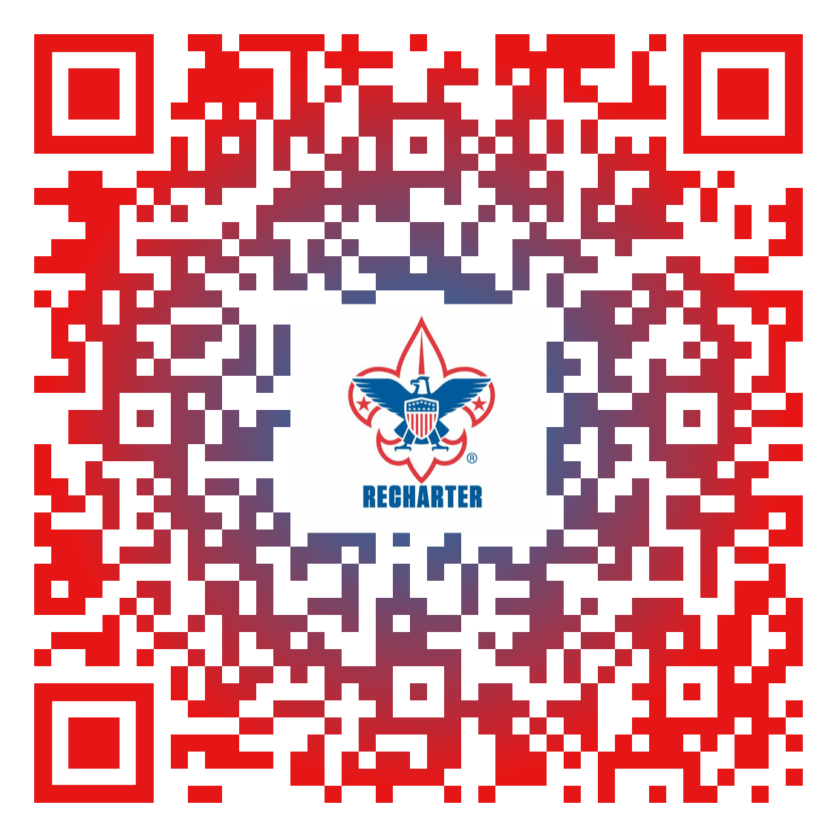
Recharter Resources
Internet Charter Renewal 2.0 - https://www.scouting.org/commissioners/internet-rechartering/
View Recent Updates, Changes, and Enhancements
Download the User Guide
Review the FAQs
Review the Internet Recharter Responses to Forum-Related Questions/Discussions helpdesk
Review the Internet Recharter Video
URL: Internet Charter Renewal 2.0 - https://advancements.scouting.org
Notes:
These resources are valuable to review prior to recharter system opening as they can answer many of your questions.

Slide 15
SVMBC Forms and Resources
SVMBC Recharter Resource Page
2022 Journey To Excellence (Online Form)
2022 Commissioner's Challenge (Online Form)
2023 Unit Information Submission (Online Form)

Slide 16
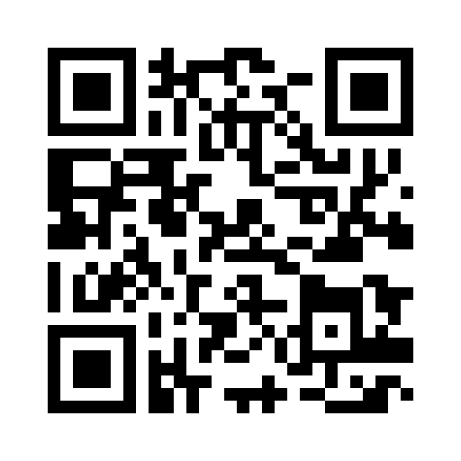
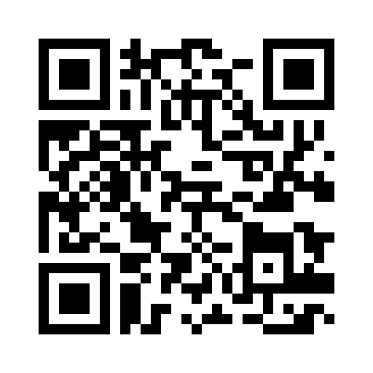
Additional Resources
Ab506 Master List for status - this list has all adults in the council and what they have done for Training and Fingerprinting as of 11 07 22
Recharter Drop Off Appoint Scheduling- For three weeks starting on 11/28 we will have District Executives available to assist with turn in of recharter at the Council Office in San Jose and the Salinas Trading Post. Sign up for a slot so we can assist you with the smooth turn in of your recharter.
San Jose Salinas

